Slide 1
Doctors Booking System
(BOOKFAST)
SUBMITTED BY,
SHIMRON RAJ
22PMC153

Slide 2
ABSTRACT
The doctors booking system is an online platform designed to facilitate the efficient scheduling and management of medical appointments between patients and doctors. The system provides a user-friendly interface where patients can search for available doctors, view their profiles and specialties, and book appointments based on their preferred date and time slots.Allowing them to book appointments from anywhere and at any time.

Slide 3
REQUIRMENTS
Customer support (live chat/contact form):Include a contact form where users can submit their queries or concerns. The form should capture relevant information like name, email, and message.
Availability of doctor:Develop a system that provides real-time information on the availability of doctors. This can be displayed in a user-friendly interface, showing the doctor's name, specialization, and available time slots.
Patient Booking:Create a booking system that allows patients to schedule appointments with doctors based on their availability.
Profile management (Patient/hospital):Implement profile management systems for patients /hospitals.

Slide 4
CONT..
Time slot and appointment date pdf generator:Develop a PDF generator that generates a printable document containing the selected appointment time slot, date, and other relevant details.
Contact with Hospital via WhatsApp:Integrate a feature that allows patients to communicate with hospitals via WhatsApp.
Hospital Ratings:Implement a rating system where patients can provide ratings for hospitals.
Payment:Integrate a payment gateway to facilitate online payments for appointments or other services.

Slide 5
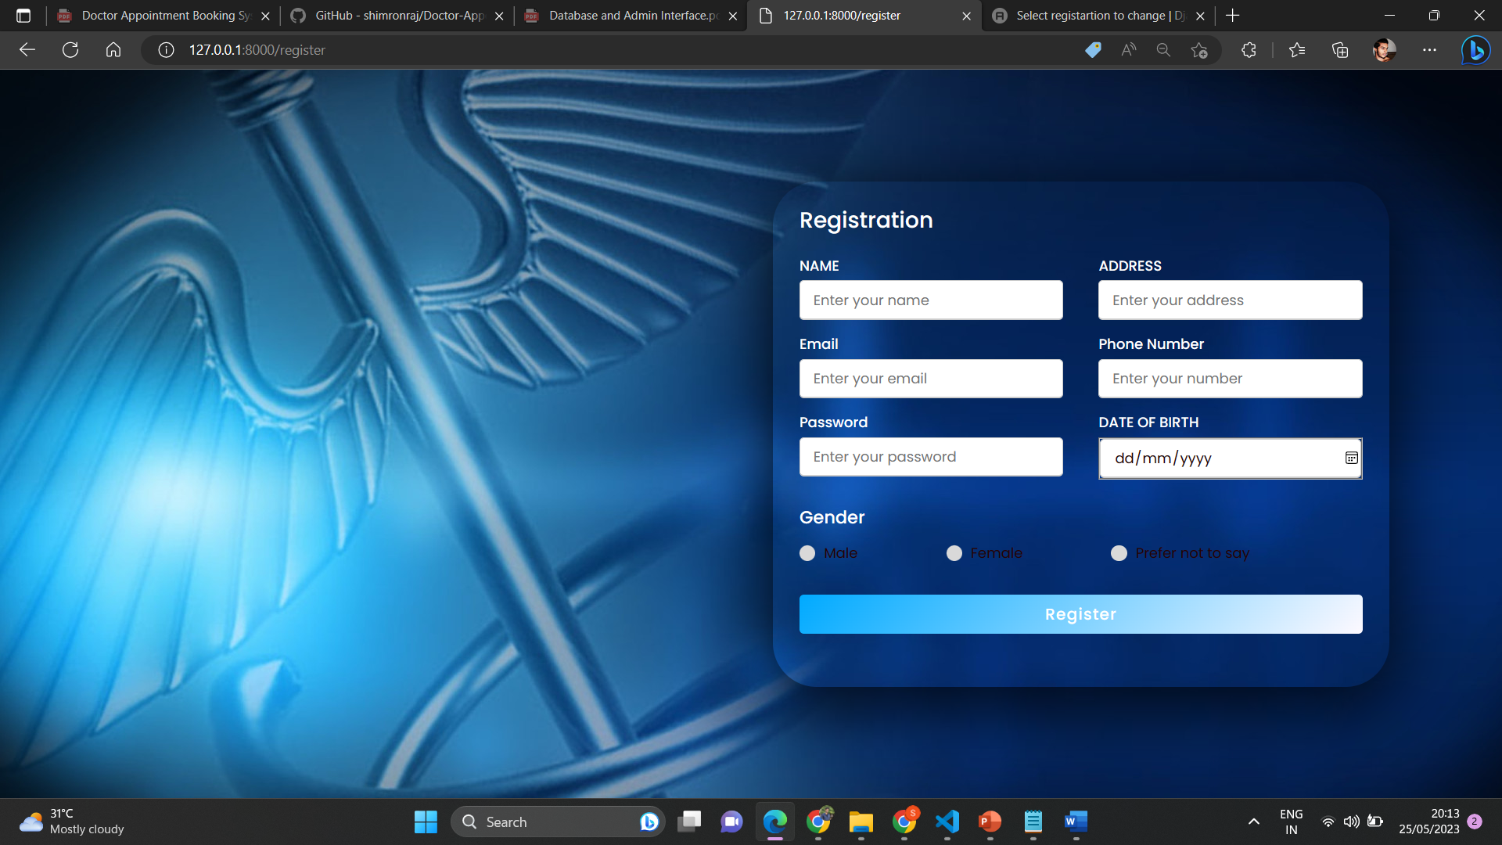
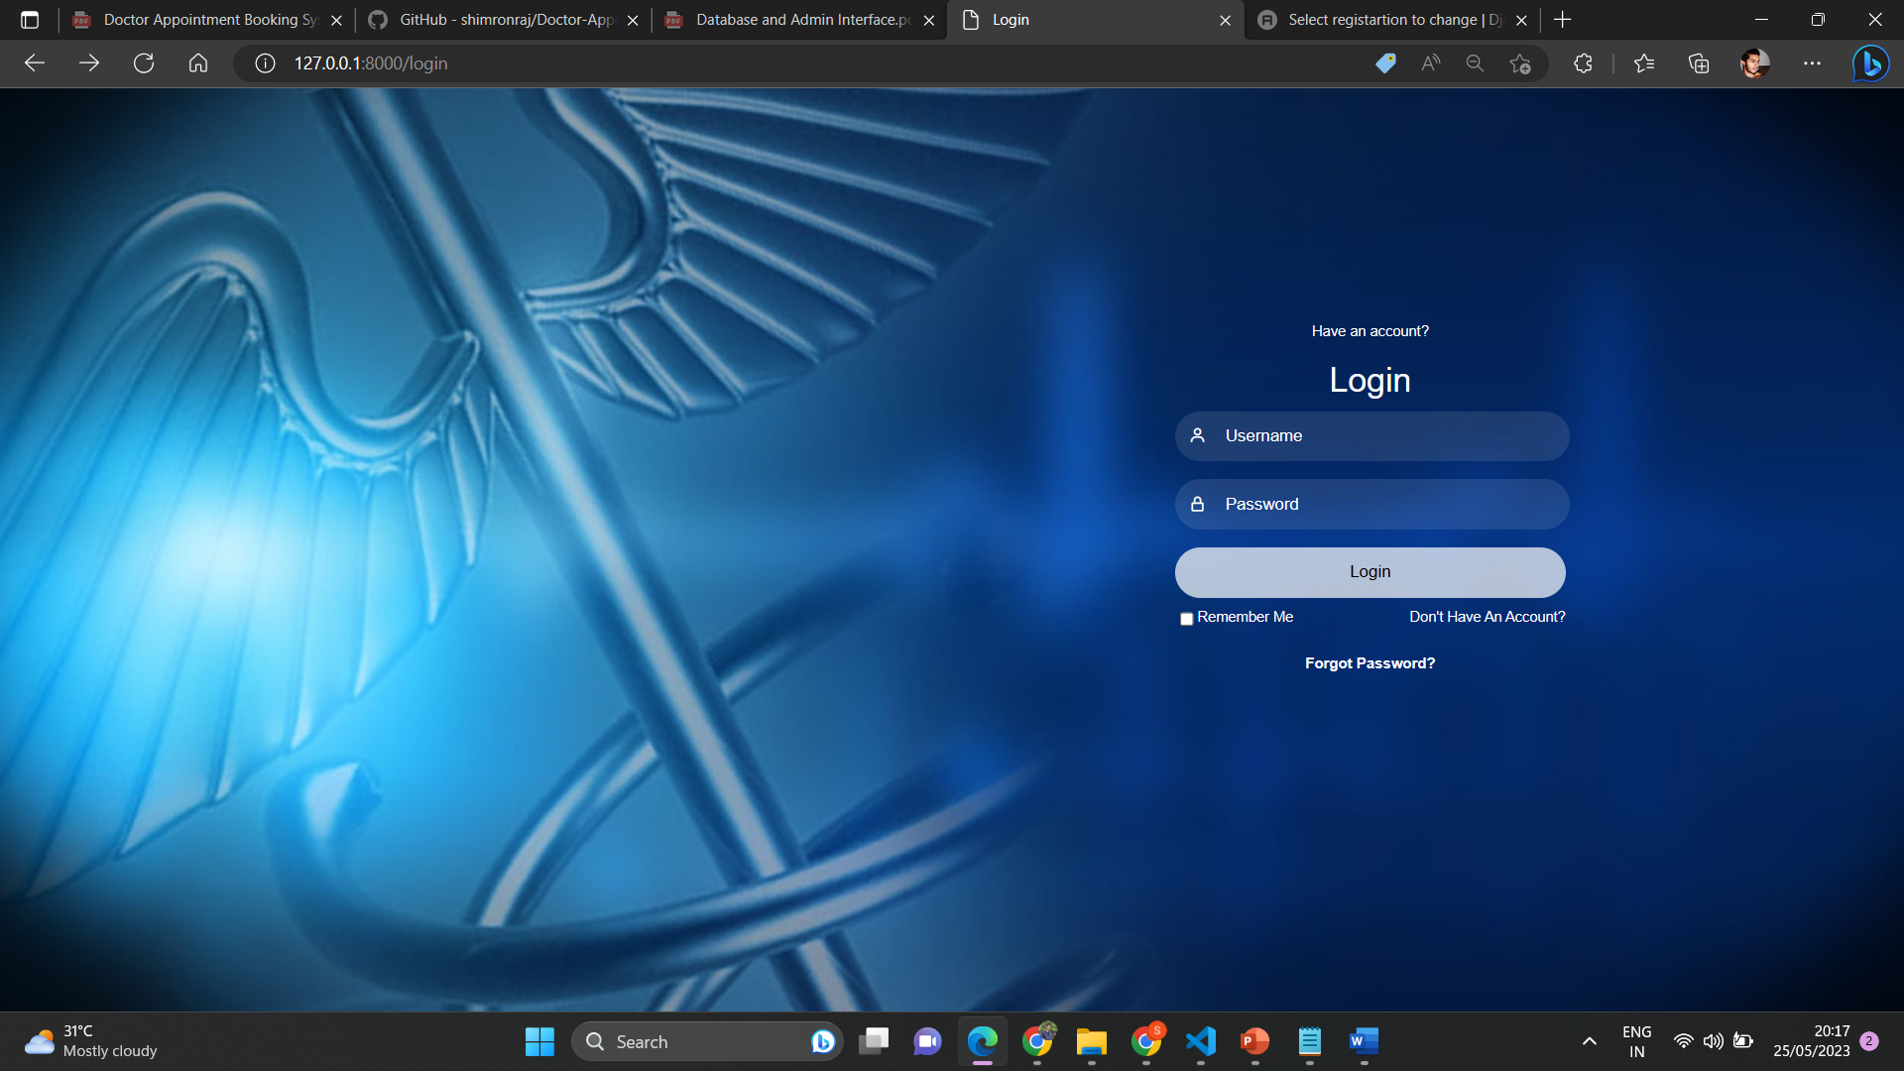
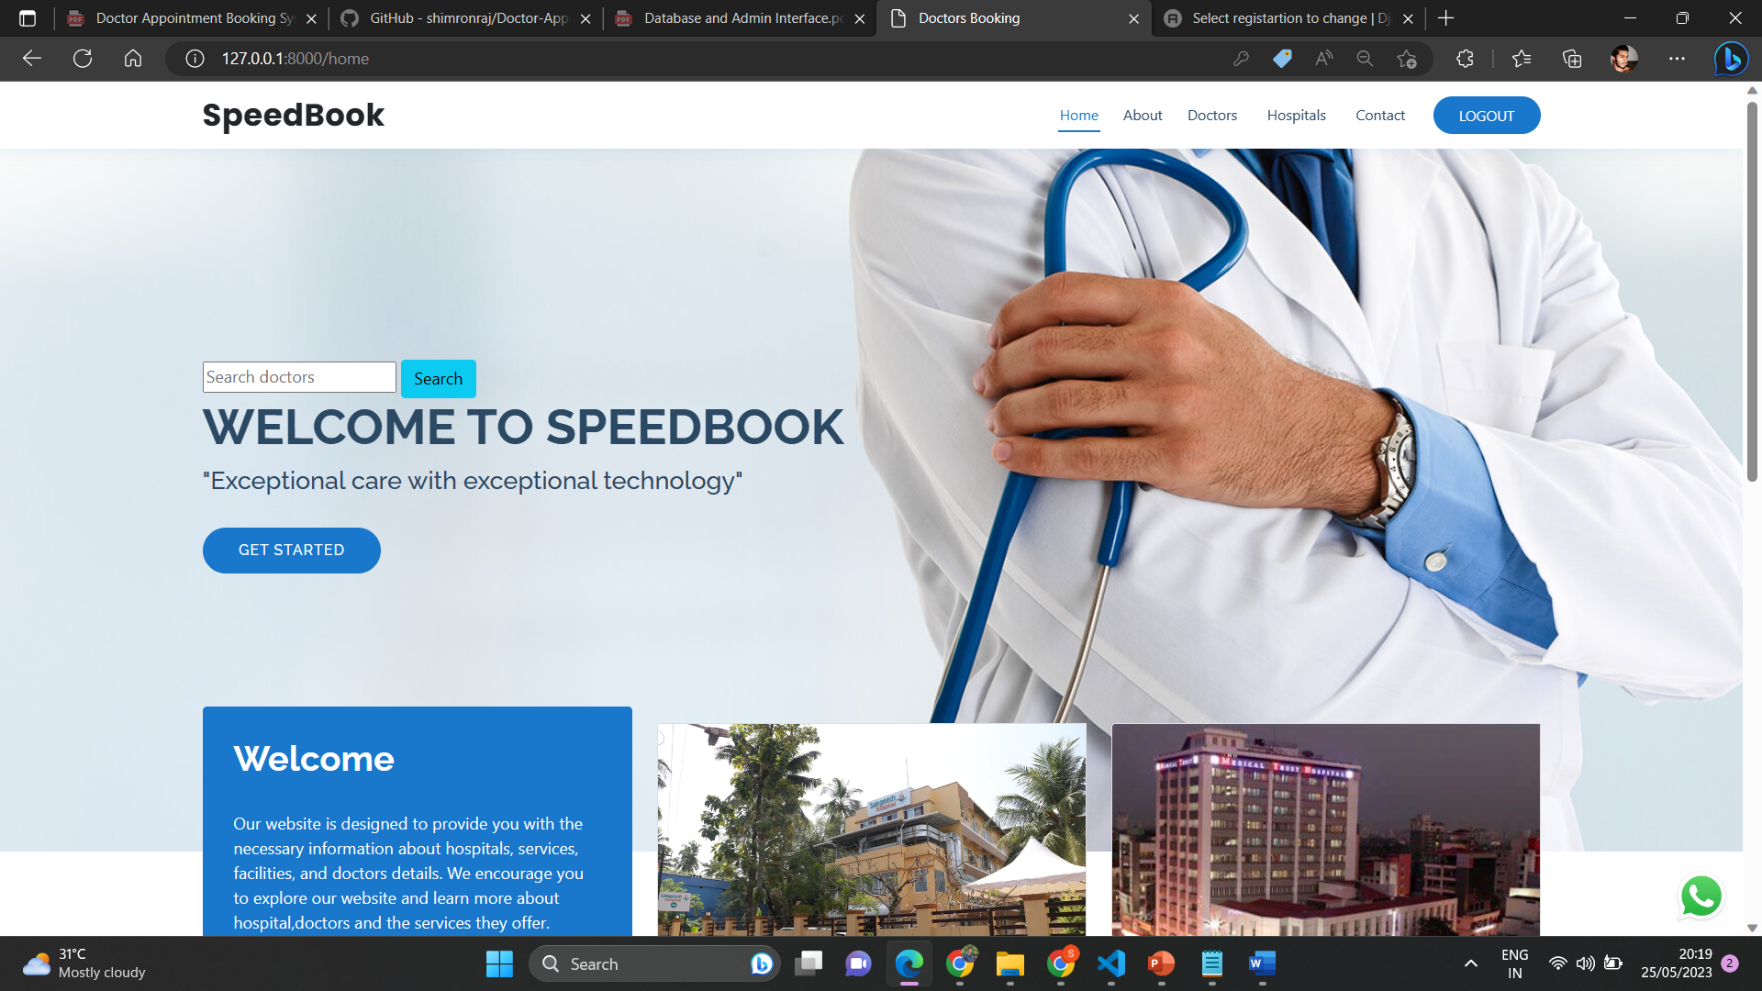
FEATURES AND HIGHLIGHTS
REGISTRATION
LOGIN
HOME
The system used by a new user. His/her give the details such as username,password,email,age,pin,phone number and the address. The user should give a unique username. If the user taken a user name that already existed cannot signup the website.The password must be 8 character contain alphanumeric.
The user can login to the page by using there own unique username and the password. The password must be contain numbers special character and the alphabet, the length become 8.
The user become login then it redirect to the users home page. In that page user can see all the features that are added by the admin

Slide 6
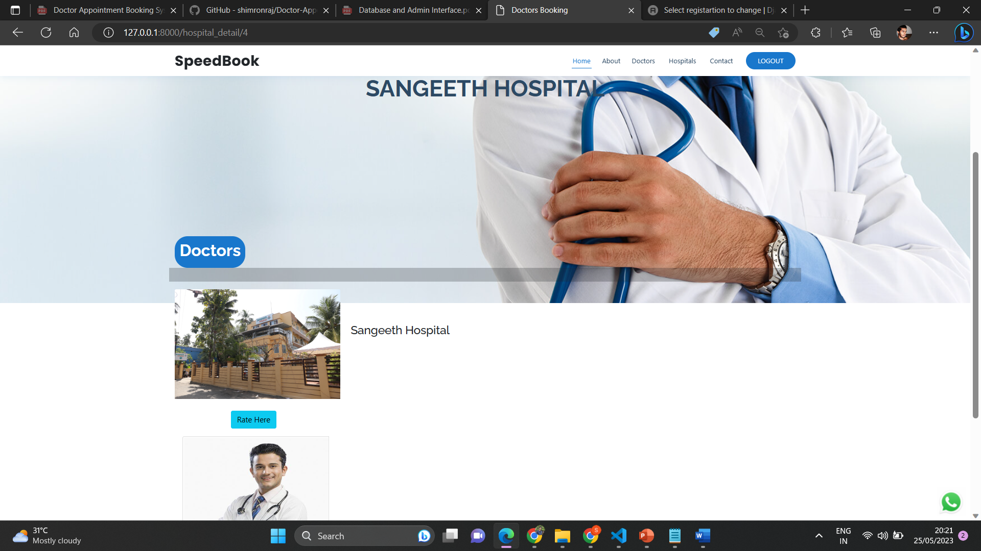
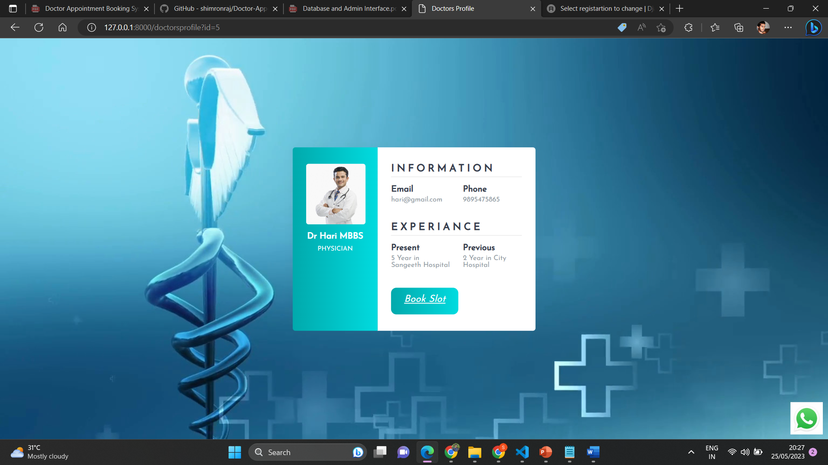
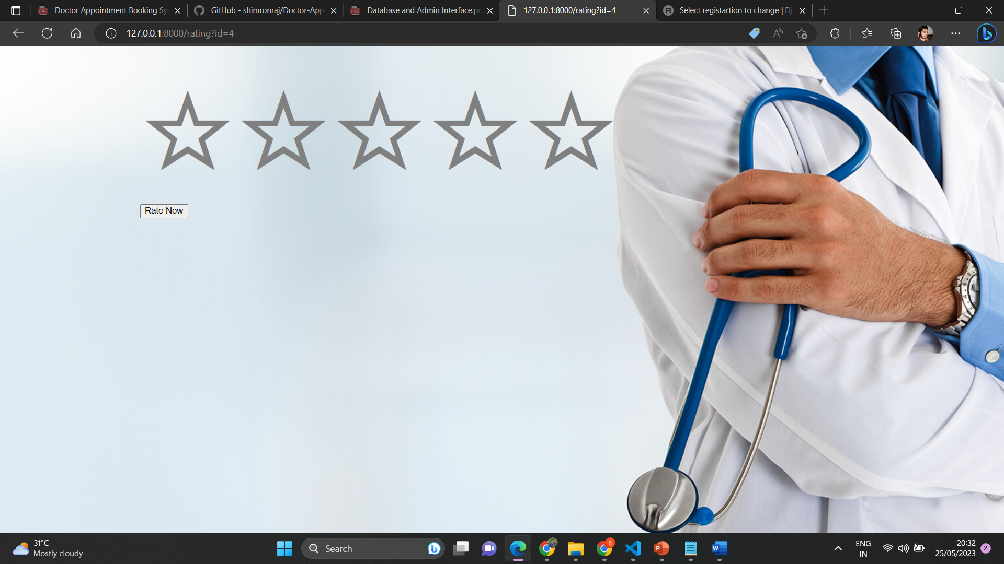
FEATURES AND HIGHLIGHTS
HOSPITAL PAGE
DOCTORS PROFILE
RATING
The user can view the doctors available to that hospital in this page and user can rate the hospital. And the main feature is user can book there slot here.
The user can view the doctors profile like name,phone number,hospital where he/she is working etc. And the main feature is user can book there slot here also.
The user can rate there hospital here.The rating containing 5 stars.

Slide 7
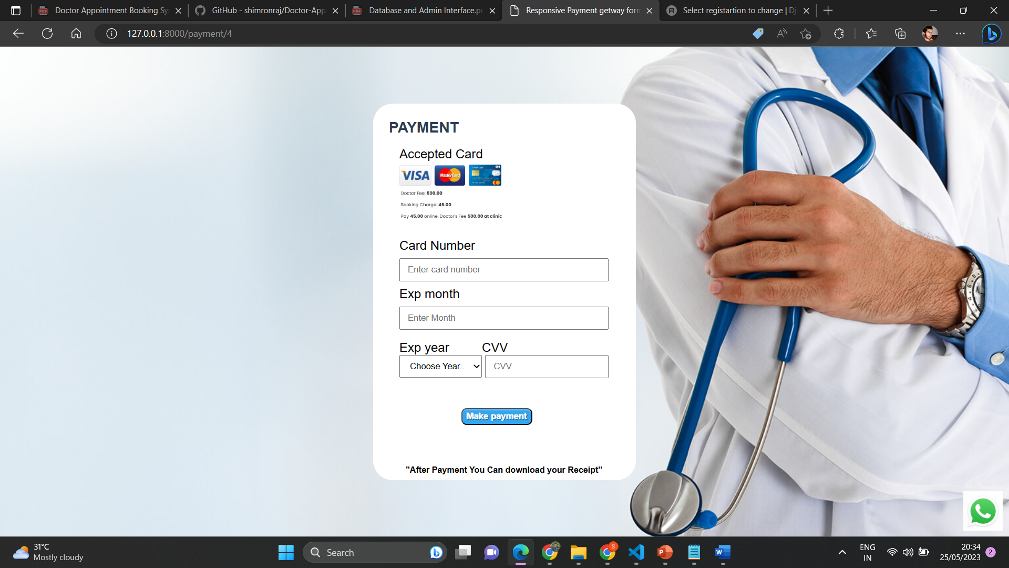
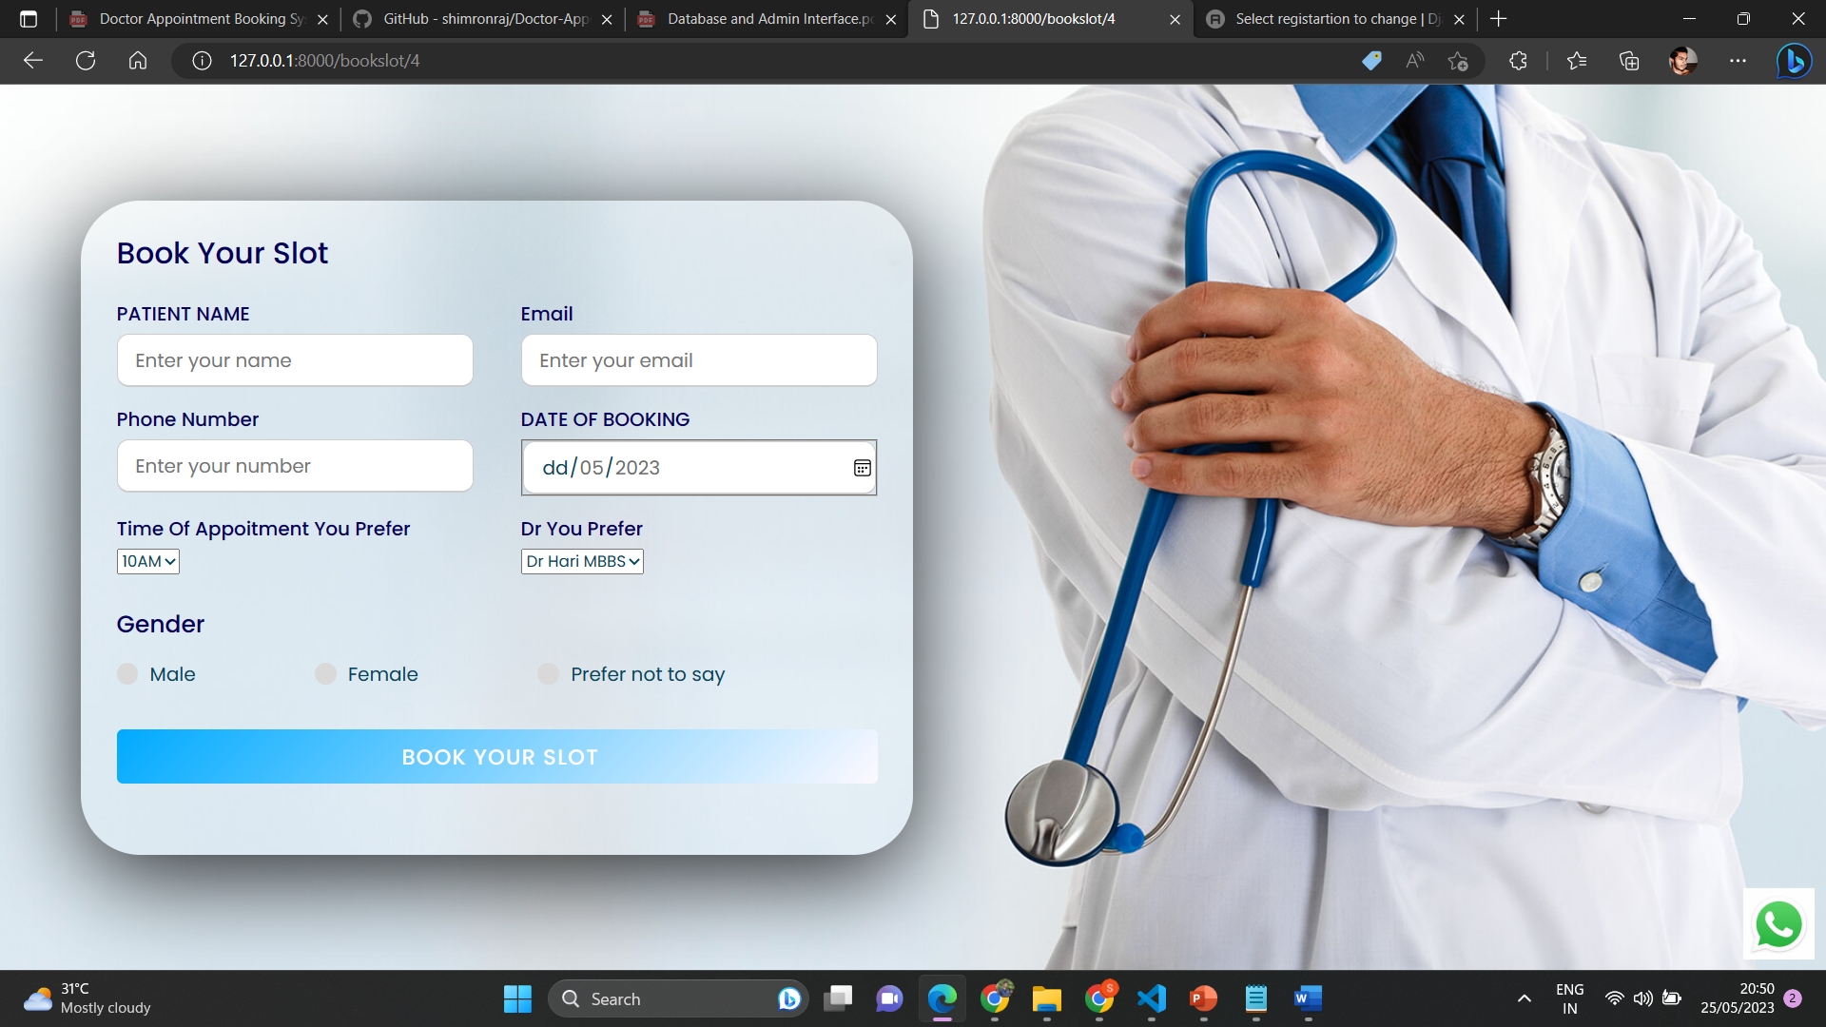
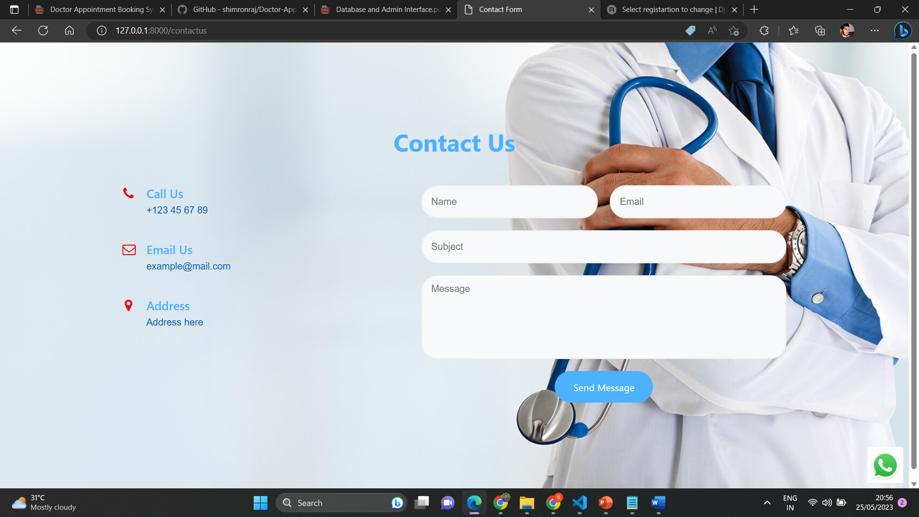
FEATURES AND HIGHLIGHTS
PAYMENT
BOOK YOUR SLOT
CONTACT FORM
After selecting the book feature user want to pay a amount called Booking Charge ,after paying it the user redirected to the book slot page to book there appointment.
After successful payment user is redirected to book there slot and user receive a confirmation pdf automatically.
The user can use this page for contact with the admin/hospital.

Slide 8
ARCHITECTURE
Front-End Interface: The front-end component would consist of a user interface that allows patients to view available doctors, their schedules, and book appointments. It should be user-friendly and accessible from various devices such as desktops, tablets, and mobile phones.
Application Layer: The application layer acts as an intermediary between the front-end and the back-end components. It handles user requests, processes data, and communicates with the database and external services. This layer includes components such as API endpoints, authentication, and authorization mechanisms.
Database: A database is crucial for storing and managing various types of data, including patient details, doctor profiles, appointment schedules, and booking records. You can use a relational database management system (RDBMS) like MySQL or PostgreSQL, or consider a NoSQL database like MongoDB if you require more flexibility in data structures.
Availability and Scheduling: The system should include features for managing doctor availability and appointment scheduling. This can involve complex algorithms to handle overlapping time slots, ensuring proper time management, and avoiding scheduling conflicts.
Scalability and Performance: Design the architecture to handle a large number of concurrent users and ensure high availability. This can involve techniques like load balancing, caching, and horizontal scaling of infrastructure components.

Slide 9
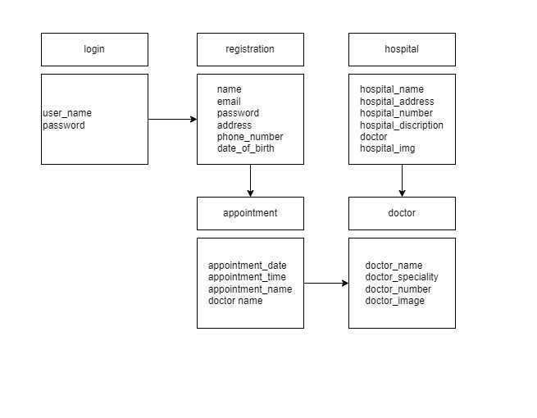
CLASS DIAGRAM

Slide 10
CHALLENGES FACED DURING DEVELOPMENT
Handling data validation and ensuring data integrity during various operations.
Integrating the inventory system with Django libraries
Creating a user-friendly interface that is intuitive and easy to navigate
Implementing secure user authentication and authorization mechanisms
Balancing the need for a visually appealing design with functional requirements.

Slide 11
IMPORTANT SCREENSHOTS WITH EXPLANATION
REGISTRATION
The system used by a new user. His/her give the details such as username,password,email,age,pin,phone number and the address. The user should give a unique username. If the user taken a user name that already existed cannot signup the website.
HOSPITAL PAGE
The user can view the doctors available to that hospital in this page and user can rate the hospital. And the main feature is user can book there slot here.

Slide 12
CONT…
BOOK YOUR SLOT
After successful payment user is redirected to book there slot and user receive a confirmation pdf automatically.
DOCTORS PROFILE
The user can view the doctors profile like name,phone number,hospital where he/she is working etc. And the main feature is user can book there slot here also.

Slide 13
FUTURE ENHANCEMENTS
Artificial Intelligence (AI) Chatbots: Implement AI-powered chatbots to provide automated support to patients. Chatbots can handle common inquiries, assist with appointment scheduling, answer basic medical questions, and provide information about doctors and services.
Real-Time Availability Updates: Enhance the system to provide real-time updates on doctor availability. Patients can view up-to-date information on doctors' schedules, including any cancellations or rescheduling, ensuring accurate and timely booking.
Advanced Search and Filters: Improve the search functionality by implementing advanced filters based on specialties, locations, languages, ratings, and other criteria. This enables patients to refine their search and find the most suitable doctors.
Mobile Application: Develop a mobile application for the doctor's booking system, allowing patients to access the system on their smartphones. The app can provide a user-friendly interface, push notifications for appointment reminders, and easy access to doctor profiles and schedules.

Slide 14
CONCLUSION
In conclusion, a doctor's booking system is a valuable tool for patients and healthcare providers to efficiently manage appointments . By implementing features such as user-friendly interfaces, secure login and registration processes and search functionalities, the system can enhance the overall user experience.Overall, a well-designed and continuously improved doctor's booking system can contribute to better patient satisfaction, optimized resource utilization.

Slide 15
REFERENCES
https://www.quickobook.com/hospitals

